Slide 1
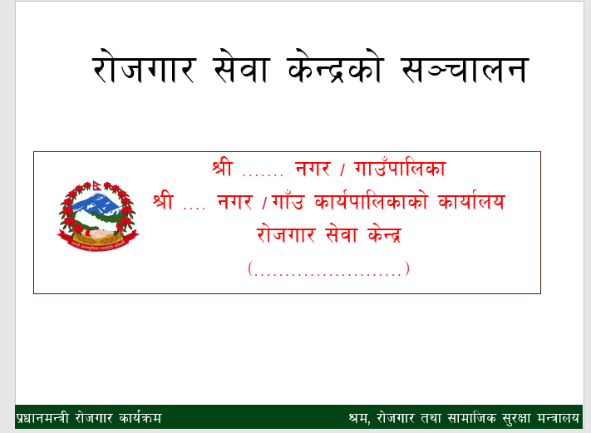

Slide 2
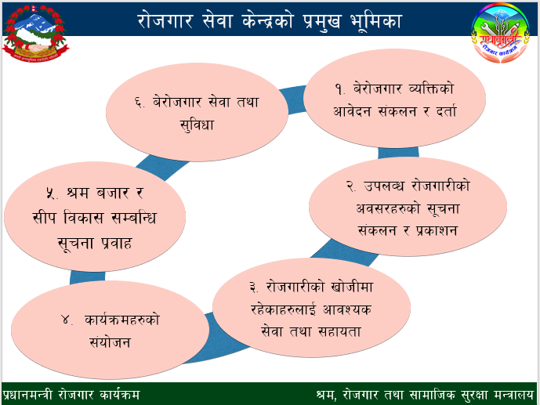
Notes:
Notes to Trainer: Please ask the questions to the participants. Effort should be make to make it as interactive as possible.

Slide 3
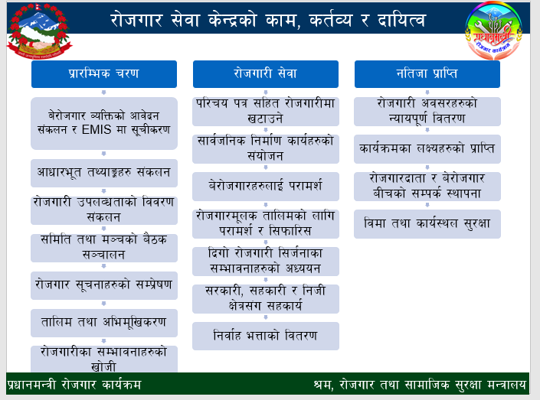
Notes:
Notes to trainer: This can be on lecture method. This is related to Section 3 of Act & Regulation.

Slide 4
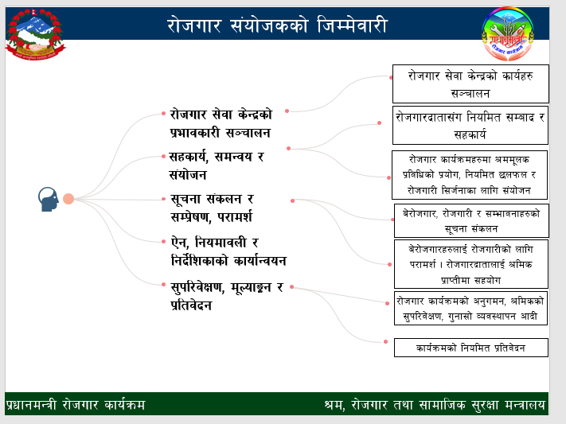
Notes:
Required skill and traits: Excellent verbal and written communication, ability to understand complex written materials, concepts and ideas, excellent interpersonal skills, superior networking skills, superior problem-solving skills, decision making skills, ability to lead and motivate others

Slide 5
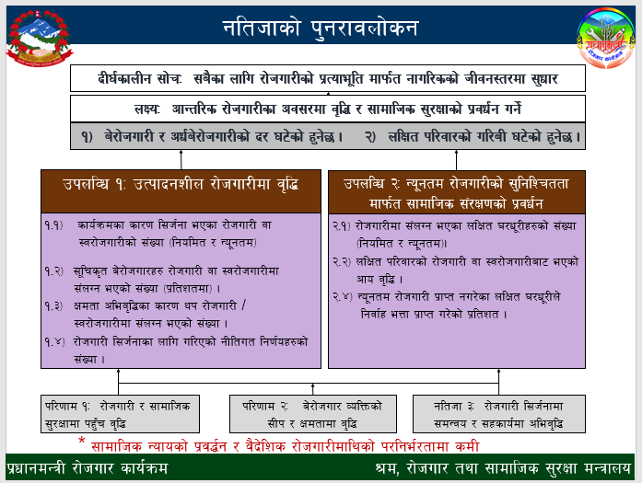
Notes:
Notes to trainer: Ask the question to participant: Do you know social security? How does it work? How can you contribute? Why we need employment to reduce the poverty and vulnerability in the society?

Slide 6
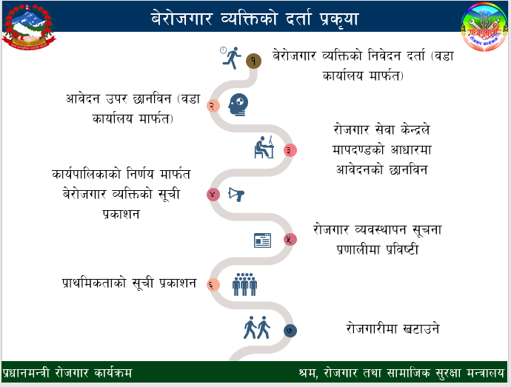
Notes:
Registration: Chaitra of each year.

Slide 7
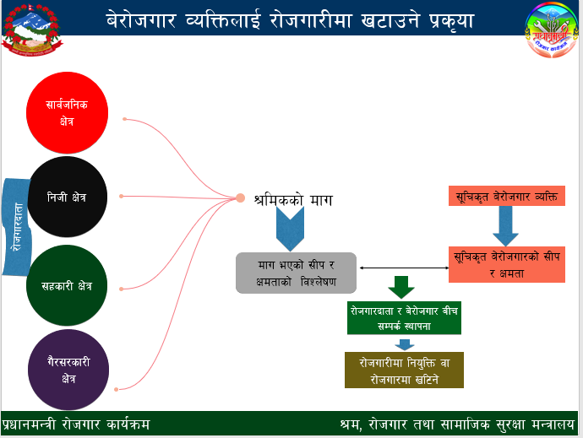
Notes:
Ask question to participant: What could be the role of Employment Coordinator?

Slide 8
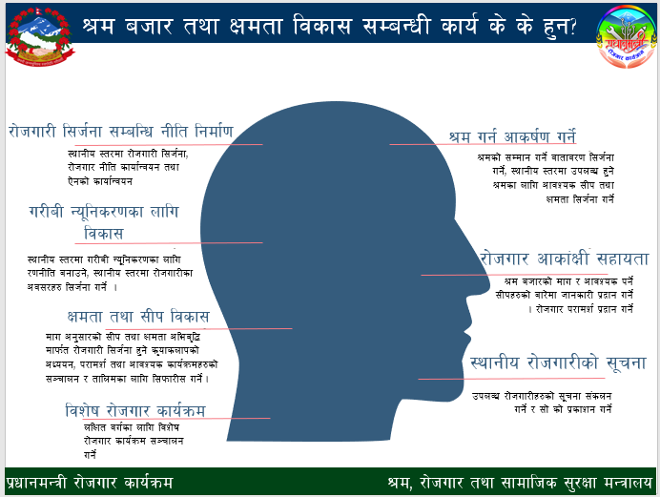
Notes:
Notes to Trainer: You can skip this slide if you do not have time.

Slide 9
धन्यवाद
Notes:
Notes to Trainer: You can skip this slide if you do not have time.

